Slide 1
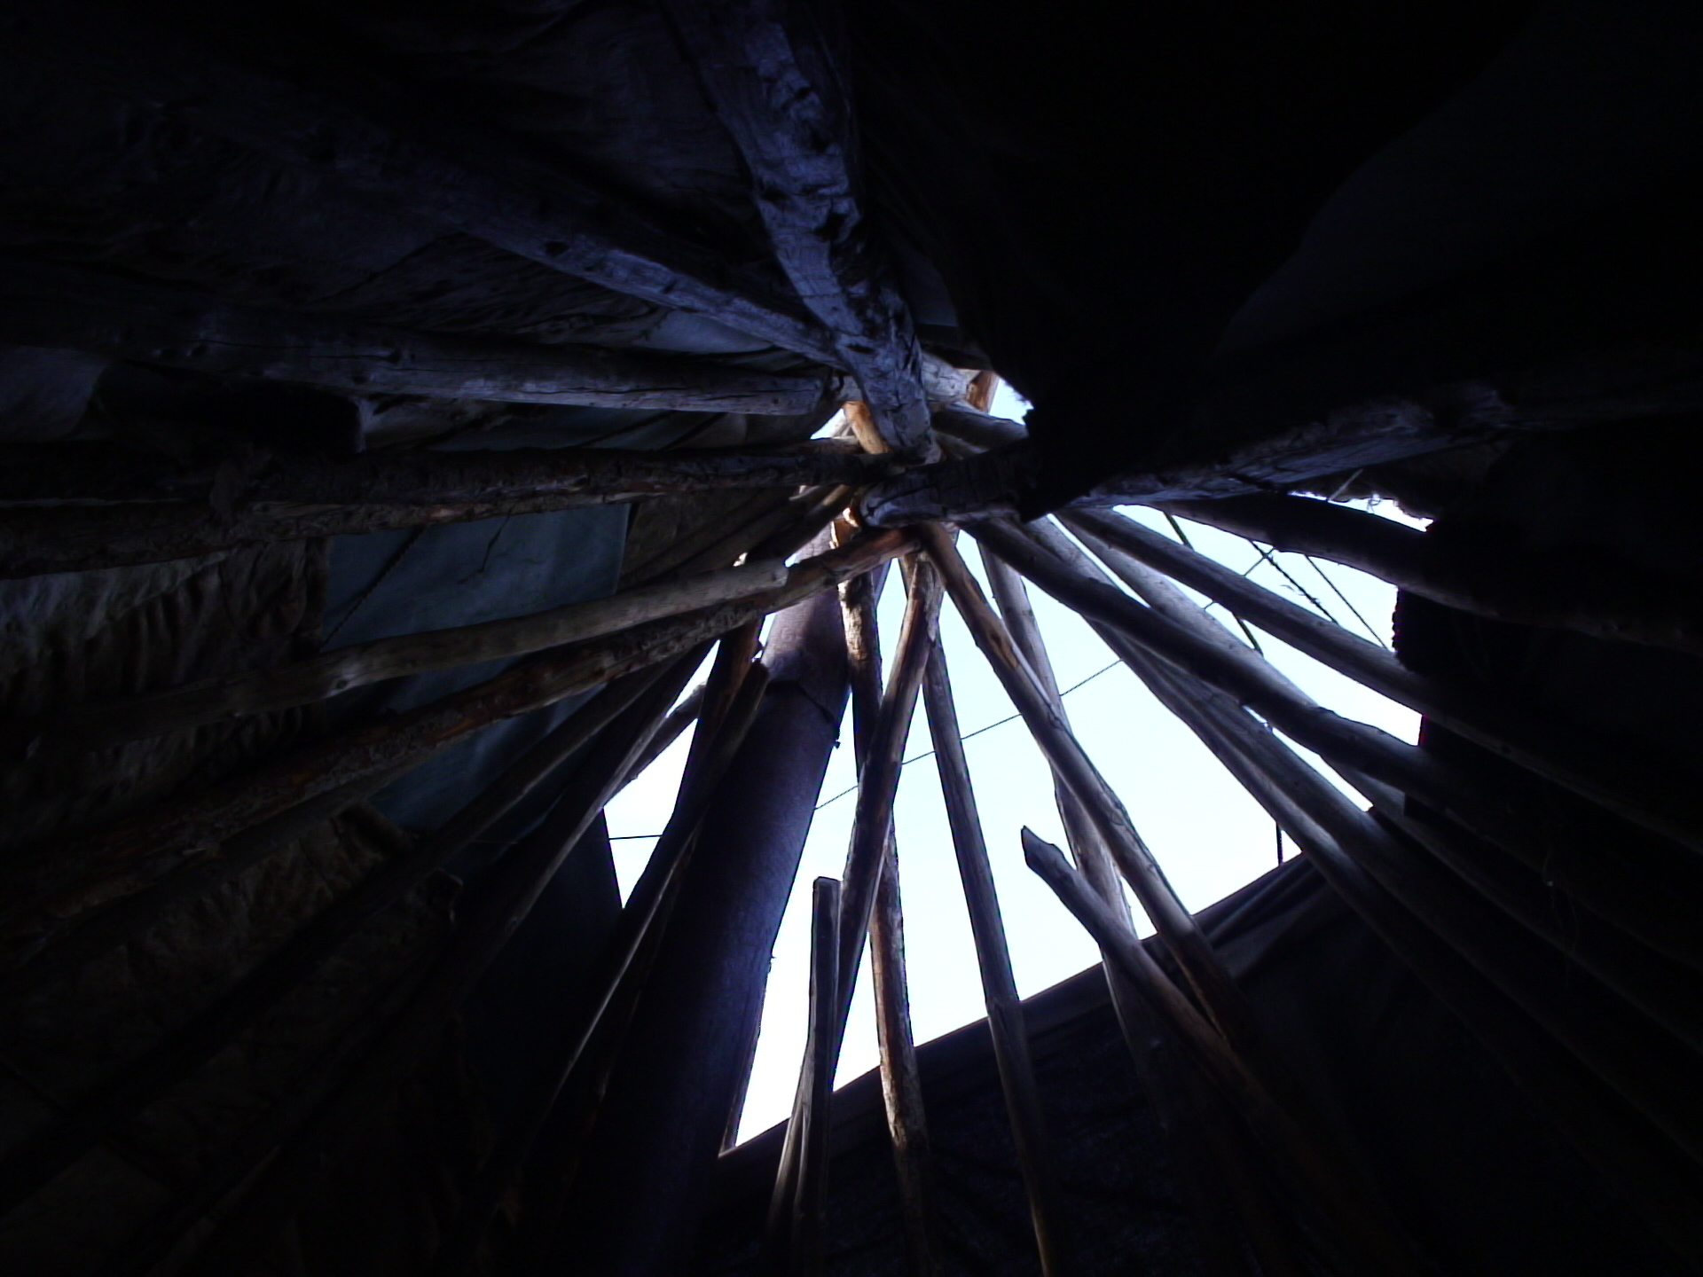
Multi-functional web-site “Minority languages of Siberia as our cultural heritage”
Москва, 01.05.2013

Slide 2
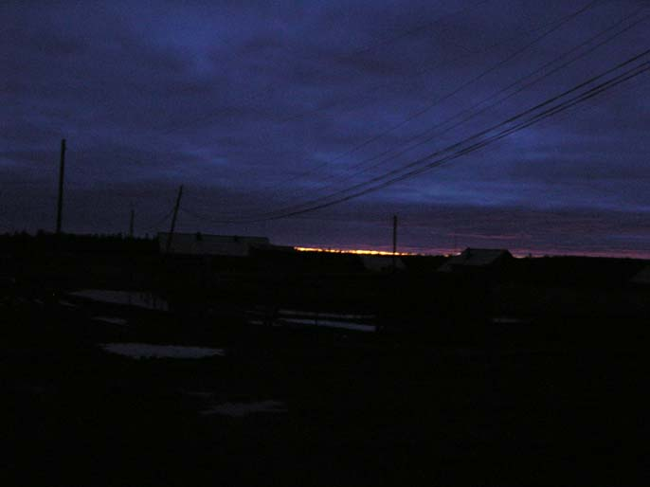
The project “Development of the web-site ‘Minority languages of Siberia as our cultural heritage’ (on the material of the languages of the basin Middle Yenisei and the Middle and the Upper Taz)” is being realized at the Laboratory for Computational Lexicography, Research Computing Centre, Lomonosov Moscow State University, with financial support from Russian Foundation for the Humanities, grant 12-04-12049 (2012-2014)
Project participants:

Slide 3
Project participants:
Olga Kazakevich (RCC MSU, Project leader)
Daria Vakhoneva (RCC MSU)
Marina Vorontsova (RCC MSU)
Julia Galiamina (RCC MSU)
Elena Kliachko (Higher School of Economy)
Larisa Pavlinskaya (Kunstkamera, SPb)
Konstantin Polivanov (Memorial)
Eugenia Renkovskaya (LLC “ABI InfoPoisk”)
Tatiana Reutt (RCC MSU)
Irina Rostunova (LLC “Studio in Pokrovka”
Alexander Chvyrev (RCC MMSU)
Project participants:

Slide 4
The objective of the project is the development of a multi-media website containing comprehensive data on autochthonous minority languages of the basins of the Middle-Yenisei and the Middle- and Upper-Taz – Selkup, Ket and Evenki.

Slide 5
The primarily informational source for the site is the Multimedia Computer Archive of materials in local dialects of Selkup, Ket and Evenki, recorded in the course of linguistic expeditions regularly organized and led within the laboratory, but we are going to draw relevant information from published works and archives as well.

Slide 6
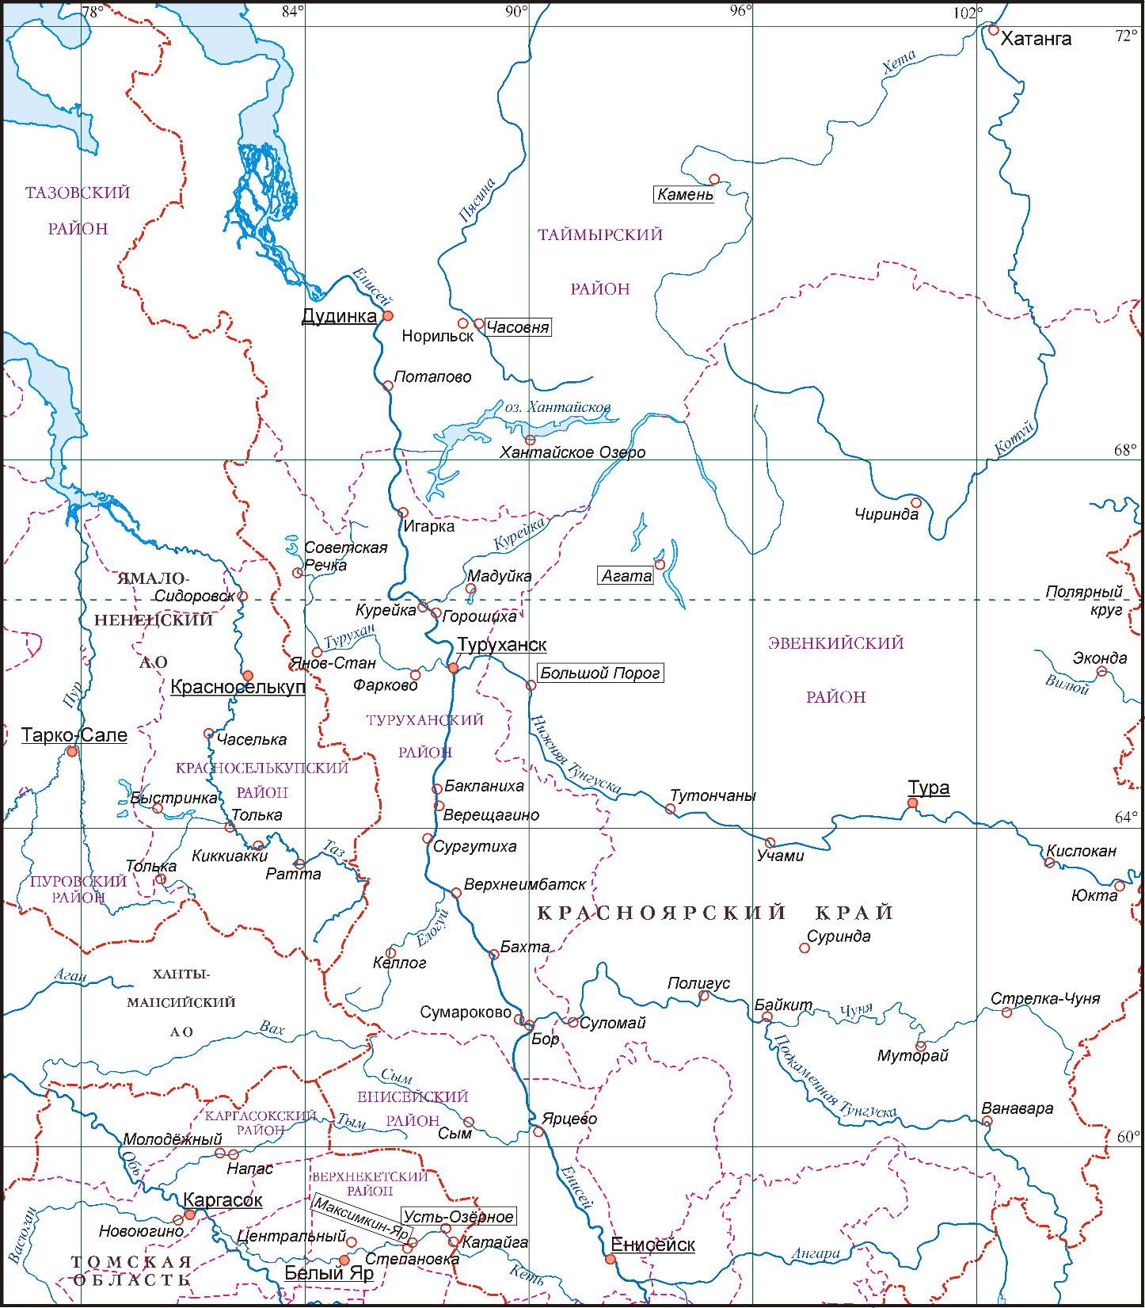

Slide 7
Working at the site, we keep two target groups in focus: on the one hand, we address the academic community – linguists, anthropologists, historians, on the other hand, we address the speakers of the languages presented on the site, those who teach or learn these languages at schools and colleges, who want to learn them or just to get acquainted with languages and cultures of Siberian peoples, an integral part of our cultural heritage.

Slide 8
On the site the following types of data are to be found:
1) sociolinguistic data characterizing the functioning and degree of preservation of Selkup, Ket, or Evenki in the surveyed villages;
2) sounding thematic dictionaries of Selkup, Ket and Evenki local dialects recorded in the field within the last decade and a half and loaded into a database, which is to be developed for that purpose;
3) annotated Selkup, Ket and Evenki text corpora containing texts of various genres in local dialects of these languages both recorded in the course of our expeditions of the last decade and a half and extracted from archives (first of all, from the archive of Peter the Great Museum of Anthropology and Ethnography, Russian Academy of Siences, Saint Petersburg);

Slide 9
4) Russian texts recorded in the field from the Russian population of the area living side by side with the Selkups, Kets and Evenkis and telling about life, traditional ways and rituals of their neighbous;
5) information on the grammar structure of the three languages in the form of grammar reference book or reference database;
6) Selkup, Ket and Evenki language learning software;
7) documentaries showing the functioning of the languages and the life of their speakers;
8) photos representing the life of the villages and their residents, our informants and the nature surroundings.

Slide 10
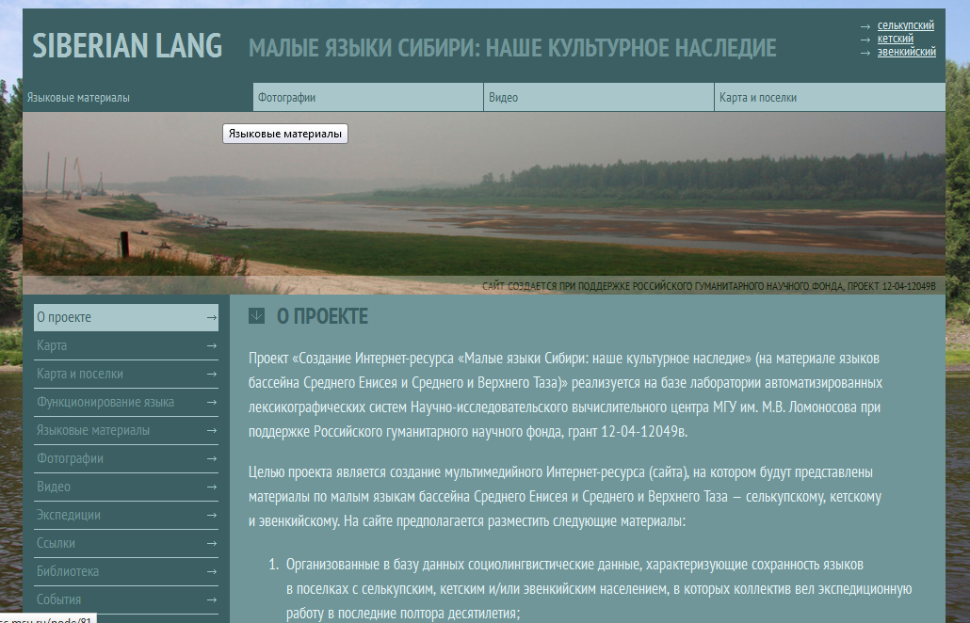

Slide 11
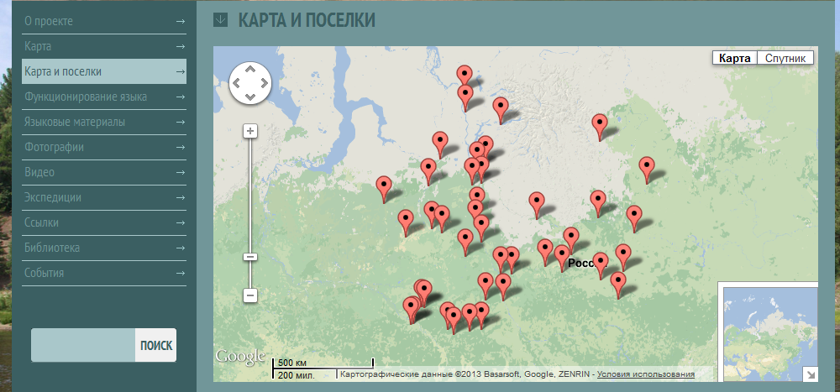

Slide 12
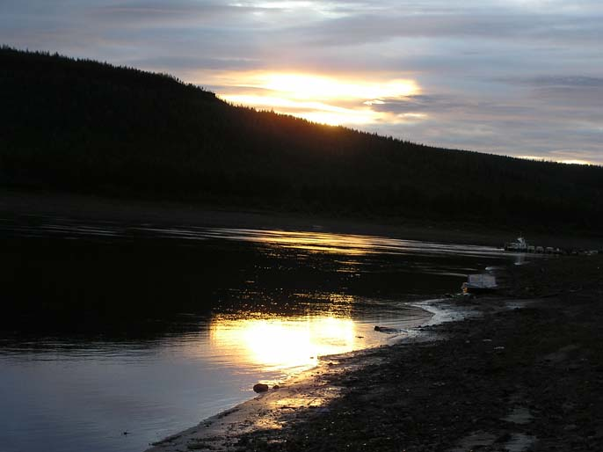
siberian-lang.srcc.msu.ru
Welcome!

